Slide 1

BLOCKCHAIN BASED EMPLOYEE STOCK OWNERSHIP PLAN
under the guidance of
Dr. RAJASEKAR.P M.E., Ph.D.,
by
AARTHI R (40120001)
RAJALASHMI R (40120072)

Slide 2
PRESENTATION OUTLINE
1.⁠Objectives
2.⁠Abstract
3.⁠Introduction
4.⁠Problem Definition
5.⁠Contributions
6.⁠Literature Survey
7.⁠Issues in Existing System
8.⁠Proposed Method
9.⁠Architecture
10.⁠Modules
11.Modules details
12.⁠Results and Discussion
13.⁠Conclusion
14.⁠Advantages
15.⁠Applications
16.⁠Paper Published
17. ⁠References

Slide 3
OBJECTIVES
The objective of the project is to leverage blockchain technology to create a transparent and secure platform for implementing an employee stock ownership plan (ESOP).
By utilizing blockchain, the project aims to provide employees with greater visibility into their company's stock ownership structure and facilitate easier participation in the ESOP program.
This will lead to increased employee engagement, motivation, and loyalty by allowing them to directly benefit from the company's success through stock ownership.
Ultimately, the project seeks to enhance overall organizational performance and create a culture of shared ownership and alignment of interests between employees and the company

Slide 4
ABSTRACT
Blockchain technology is an advanced database mechanism that allows transparent information sharing within a business network.
ESOPs are a popular mechanism for companies to offer ownership stakes to their employees, aligning their interests with the company's success.
Traditional ESOPs often face challenges related to trust, record-keeping, and liquidity.
By leveraging blockchain technology, this project aims to address these challenges and create a more robust and accessible ESOP framework.
This project proposes the implementation of a blockchain-based Employee Stock Ownership Plan (ESOP) to enhance transparency, security, and efficiency in managing employee stock ownership.

Slide 5
INTRODUCTION
A Blockchain-based Employee Stock Ownership Plan (ESOP) is a revolutionary and innovative approach to managing employee stock ownership within a company.
By utilizing blockchain technology, companies can create a transparent and secure system for employees to manage and track their stock options.
This ensures that employees have real-time visibility and control over their ESOP holdings, promoting trust and accountability.
Additionally, blockchain eliminates the need for intermediaries, reducing costs and streamlining the process of managing employee stock ownership.

Slide 6
⁠PROBLEM DEFINITION
Traditional Employee Stock Ownership Plans (ESOPs) often face challenges related to transparency, security, and efficiency in managing stock ownership among employees.
These challenges can lead to issues such as disputes over ownership, lack of trust in the system, and cumbersome administrative processes.
To address these issues, there is a need for a blockchain-based ESOP solution that provides a transparent, secure, and automated platform for managing employee stock ownership.

Slide 7
CONTRIBUTIONS
A blockchain-based ESOP offers
Transparency and Trust
Security
Efficiency
Accessibility
Cost Savings
Compliance and Auditability

Slide 8
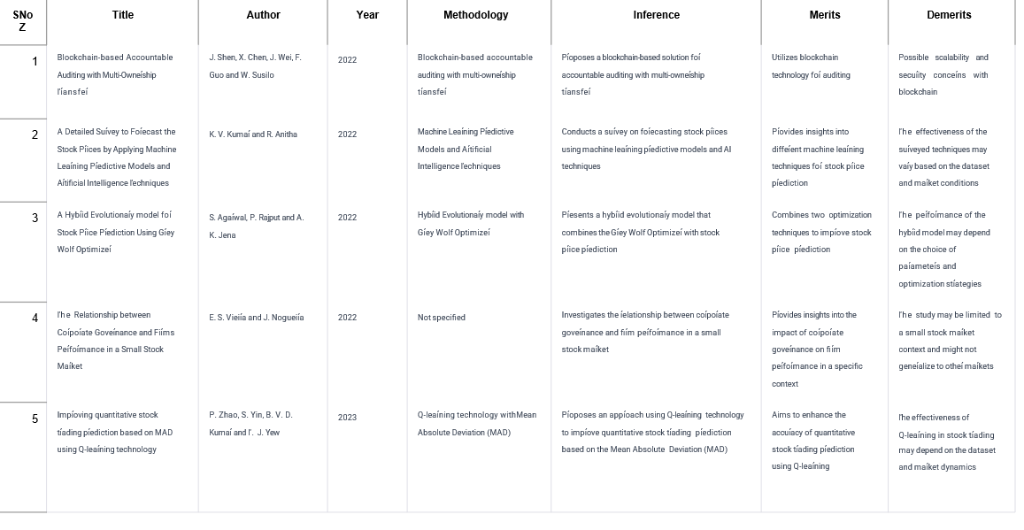
LITERATURE SURVEY

Slide 9
⁠ISSUES IN EXISTING SYSTEM
Lack of Transparency: In traditional ESOPs, employees may not have clear visibility into how the plan operates or how their ownership stake is calculated.
Complexity: ESOPs can be complex to understand, especially for employees who are not familiar with financial or investment concepts
Valuation Challenges: Determining the fair market value of company stock for ESOP purposes can be challenging, particularly for privately held companies or those with fluctuating market conditions.
Liquidity Concerns: Employee stock in an ESOP may be illiquid, meaning it cannot be easily converted into cash.
Risk Concentration: Employees who hold a significant portion of their wealth in company stock through an ESOP may face increased financial risk.

Slide 10
PROPOSED METHODS
Platform Selection: Choose a suitable blockchain platform (e.g., Ethereum, Hyperledger) based on scalability, security, and compatibility.
Smart Contract Development: Create smart contracts for automated stock issuance, vesting schedules, and dividend distributions.
Tokenization: Tokenize employee ownership stakes for transparent tracking on the blockchain.
Identity Management: Implement robust authentication systems to ensure secure access for authorized users.
User Interface Design: Develop a user-friendly interface for employees to access ownership information and participate in voting.
Security Measures: Employ encryption, multi-factor authentication, and regular audits to protect sensitive data.
Monitoring and Improvement: Continuously monitor platform performance, gather feedback, and iterate for ongoing enhancement.

Slide 11
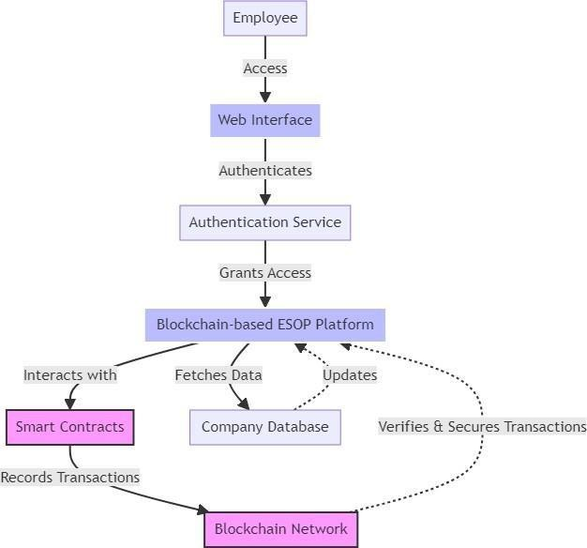
ARCHITECTURE

Slide 12
MODULES
1. Financial Management Module
2. Human Resources Module
3. Sales and Marketing Module
4. Inventory Control Module
5. Customer Relationship Management (CRM)
6. Supply Chain Management
7. Business Intelligence and Analytics
8. Project Management
9. E-commerce Integration
10. Compliance and Regulatory Module WORKING PRINCIPLE

Slide 13
MODULES DETAILS
Financial Management Module:
Tracks financial transactions, manages budgets, forecasts cash flow, and generates financial reports to facilitate effective financial decision-making and ensure compliance with accounting standards.
Human Resources Module:
Manages employee information, such as payroll, benefits, performance evaluations, training, and recruitment. Facilitates workforce planning, talent management, and compliance with labor laws and regulations.
Sales and Marketing Module:
Tracks sales activities, manages customer relationships, and analyzes marketing campaigns to optimize sales performance. Integrates with CRM systems to streamline lead generation, conversion, and retention processes.
Inventory Control Module:
Monitors inventory levels, tracks stock movements, and manages reorder points to optimize inventory turnover, minimize stockouts, and reduce carrying costs. Integrates with sales and purchasing modules to ensure accurate inventory management.
Customer Relationship Management (CRM):
Centralizes customer data, tracks interactions across various touchpoints, and analyzes customer behavior to improve engagement, loyalty, and retention. Enables personalized communication and targeted marketing efforts.

Slide 14
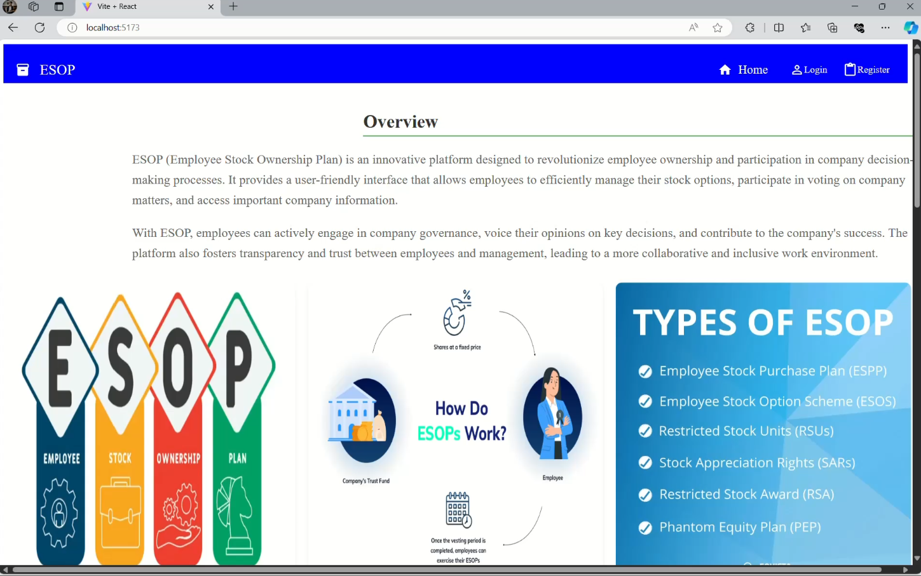
RESULTS

Slide 15
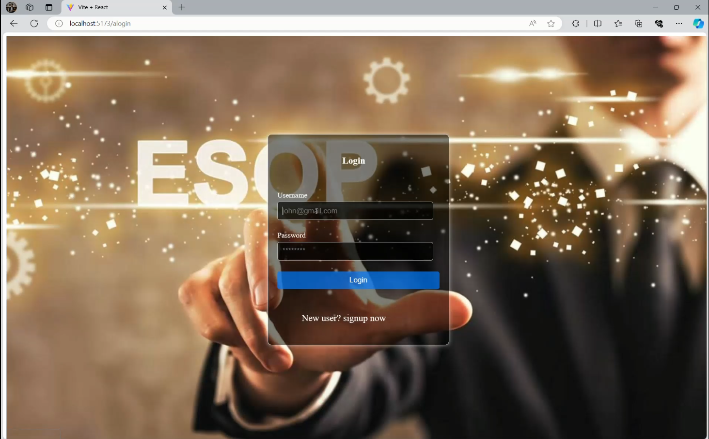
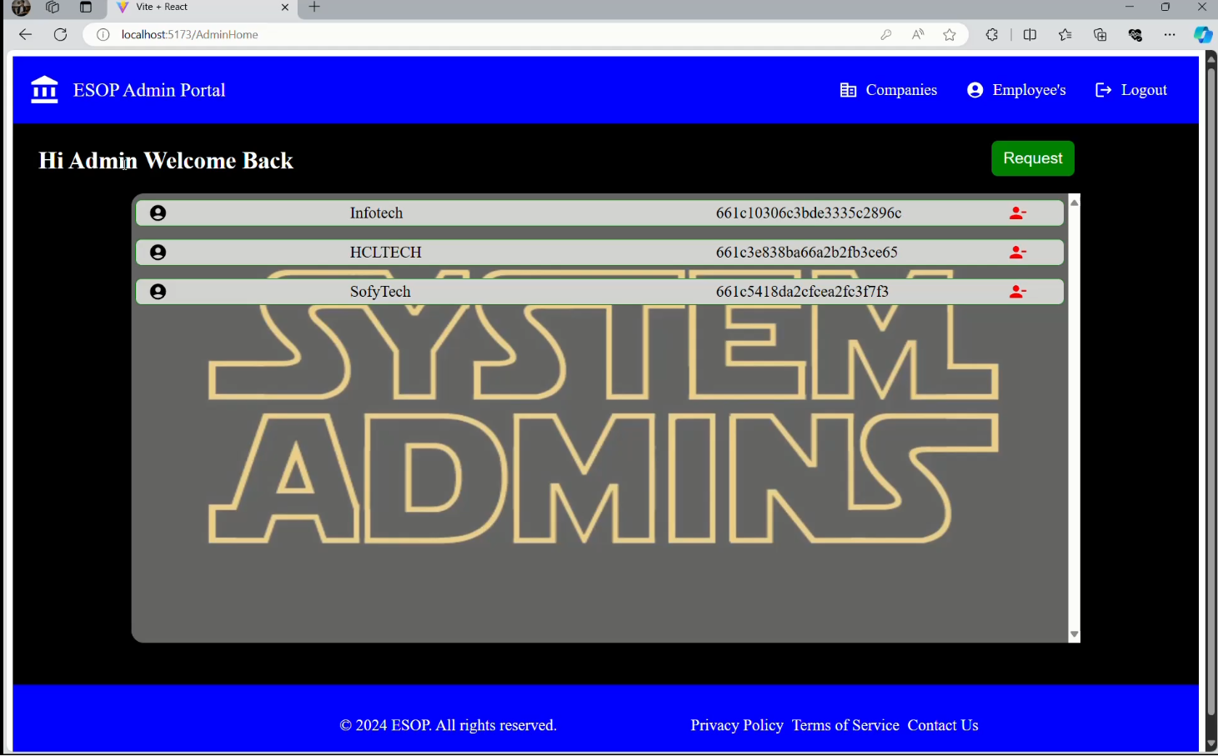

Slide 16
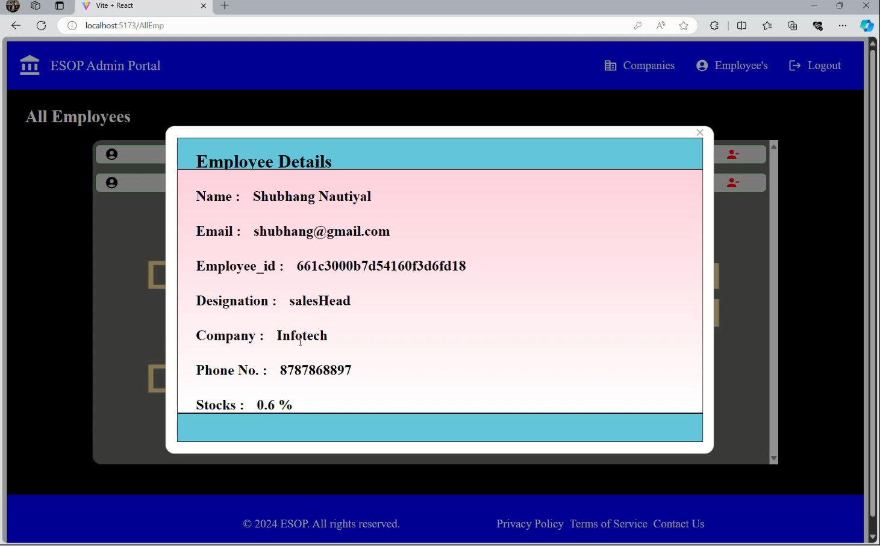
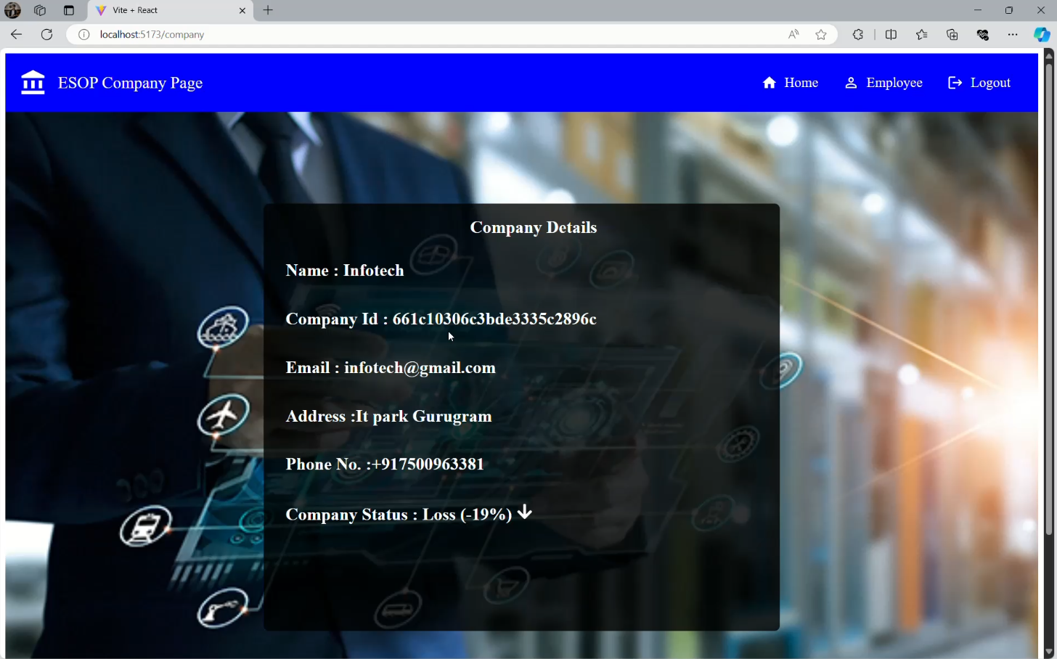

Slide 17
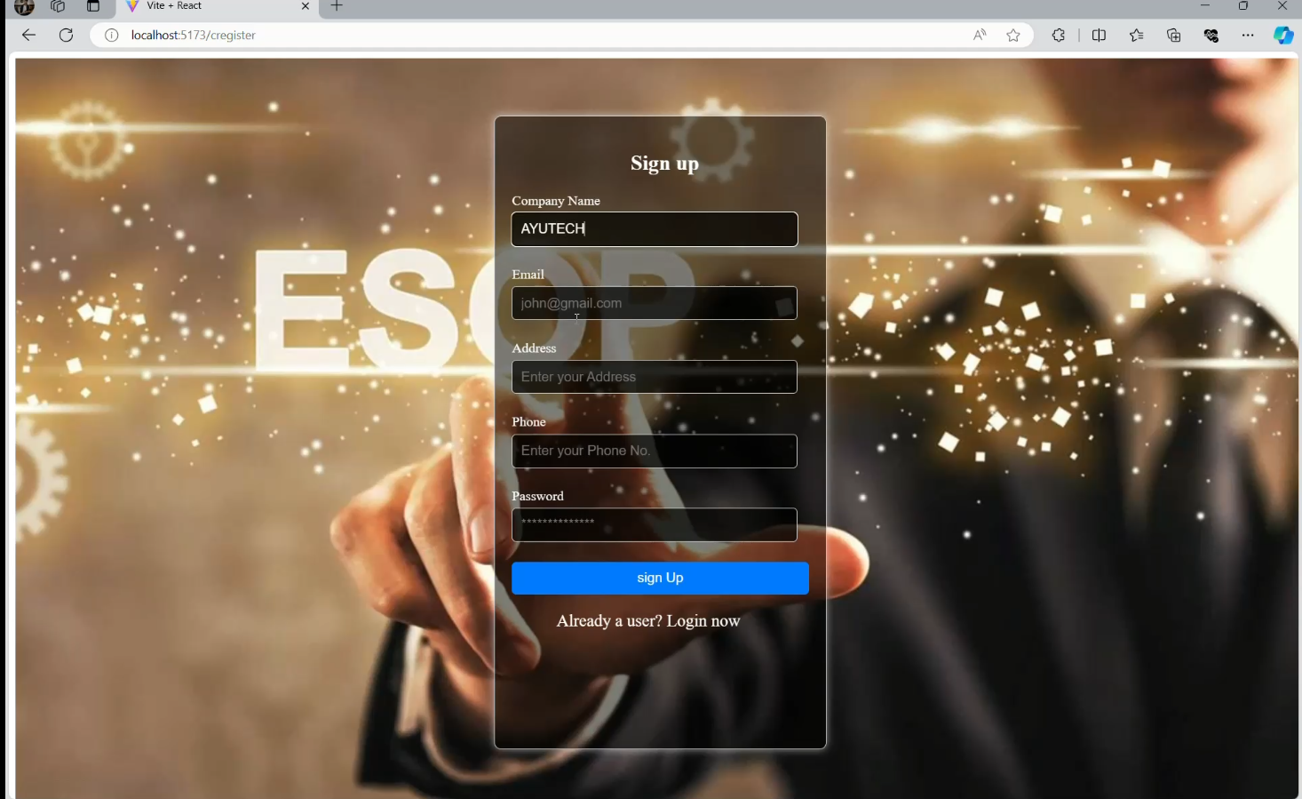
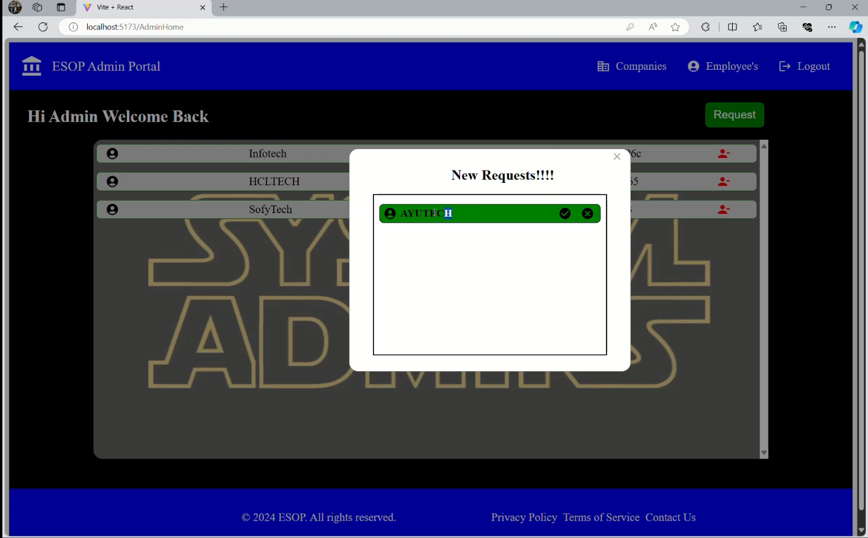

Slide 18
DISCUSSION
Enhanced Security Features: Implementing advanced security measures such as multi-factor authentication, biometric verification, and encrypted communication channels to fortify the system against cyber threats and unauthorized access.
Enhanced Governance Mechanisms: Implementing decentralized governance mechanisms such as DAOs (Decentralized Autonomous Organizations) to empower stakeholders with voting rights and decision-making capabilities regarding the management of the employee stock ownership plan.
AI and Machine Learning Integration: Leveraging AI and machine learning algorithms to optimize stock allocation strategies, detect anomalies in transaction patterns, and provide personalized recommendations for employees based on their financial goals and risk profiles

Slide 19
⁠CONCLUSION
A Blockchain based Employee Stock Ownership Plan (ESOP) offers a secure and transparent way for companies to allocate ownership stakes to their employees. By leveraging blockchain technology, all transactions and ownership records are securely stored on a decentralized ledger, providing an immutable and tamper-proof system that ensures the integrity of the ESOP.
Employees can access real-time information about their ownership stakes, track the performance of company stocks, and participate in voting processes seamlessly through smart contracts. This innovative approach enhances trust and transparency between employees and the company, fostering a sense of ownership and alignment of interests.
Additionally, blockchain technology enables faster and more efficient execution of stock transactions, reducing administrative overhead and ensuring compliance with regulatory requirements. Overall, a Blockchain based ESOP revolutionizes the way companies distribute ownership to employees, creating a more equitable and engaging work environment while streamlining processes and enhancing security.

Slide 20
ADVANTAGES
Transparency and Trust.
Immutable Recordkeeping
Efficiency
Global Accessibility
Reduced Intermediaries
Enhanced Security
Faster Settlement
Compliance and Regulatory Advantages

Slide 21
APPLICATIONS
Startups and Tech Companies
Global Corporations
Small and Medium Enterprises (SMEs
Financial Services
Public Sector and Nonprofit Organizations
Employee-Owned Cooperatives
Tokenized Equity Crowdfunding
Decentralized Autonomous Organizations (DAOs)

Slide 22
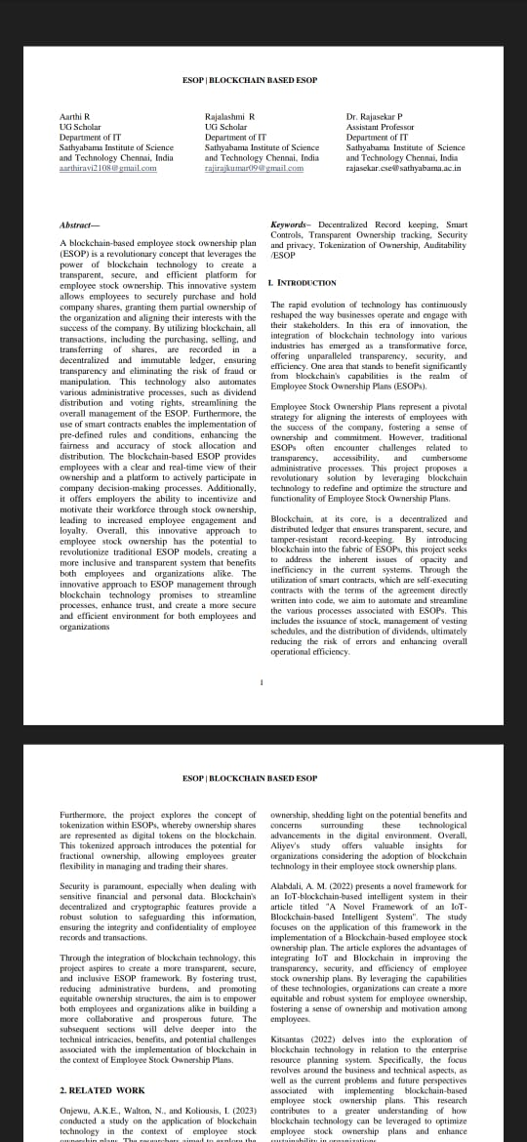
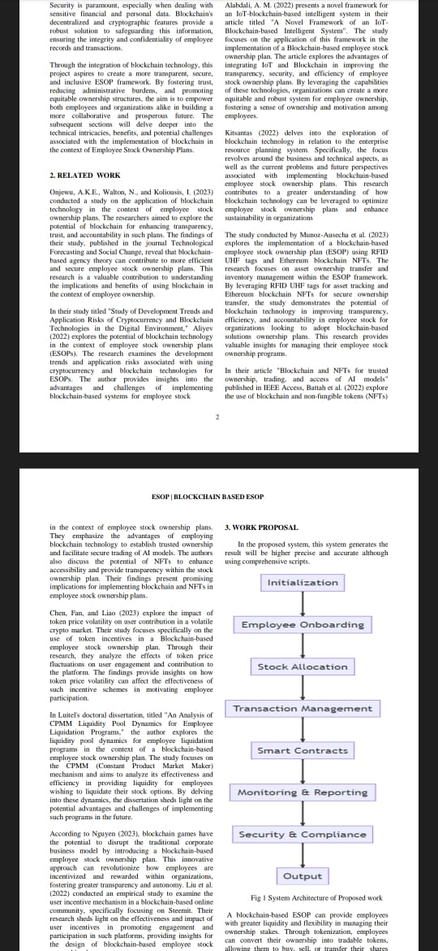
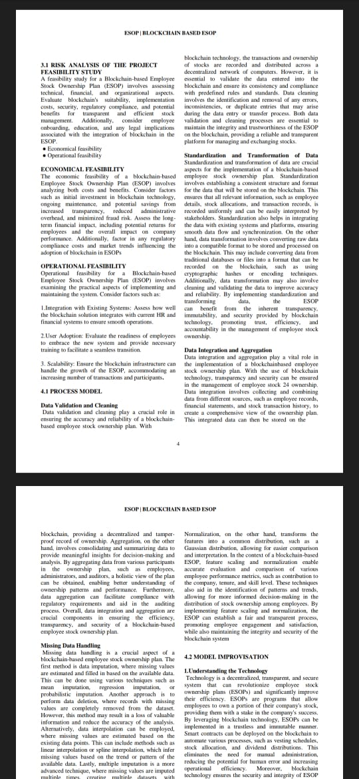
PAPER PUBLISHED

Slide 23
REFERENCES
Title: "Blockchain Technology for Employee Stock Ownership Plans" , Author: John Doe Journal/Conference: Proceedings of the International Conference on Blockchain Technology
Title: "Enhancing Transparency and Trust in Employee Stock Ownership through Blockchain" , Author: Jane Smith Journal: Journal of Corporate Finance and Accounting
Title: "Implementing a Decentralized Employee Stock Ownership Plan using Smart Contracts", Author: Michael JohnsonJournal/Conference: IEEE International Conference on Blockchain and Cryptocurrency (ICBC)
Title: "Blockchain-based Employee Equity Management for Startups",Author: Emily Adams Journal: Journal of Entrepreneurship and Innovation
Title: "Blockchain Technology in HR: The Future of Employee Stock Ownership Plans" , Author: David Williams Journal: Human Resource Management Review

